Slide 1

SafeHome
Smart Apartment Security System
Group 14
E/17/065 Kanishka Dilhan
E/17/212 Dananjaya Morais
E/17/312 Ishini Udara

Slide 2


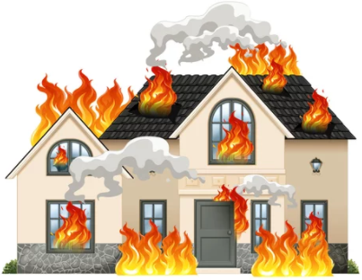


Problems with Apartment Security
Problems with Security
Risk of house been burglarized
Risk of family safety
Lack of inner peace thinking house and belongings are at a risk
Problems with existing solutions
High cost
Installation is not easy
Not focused on the needs of people in apartments
01

Slide 3
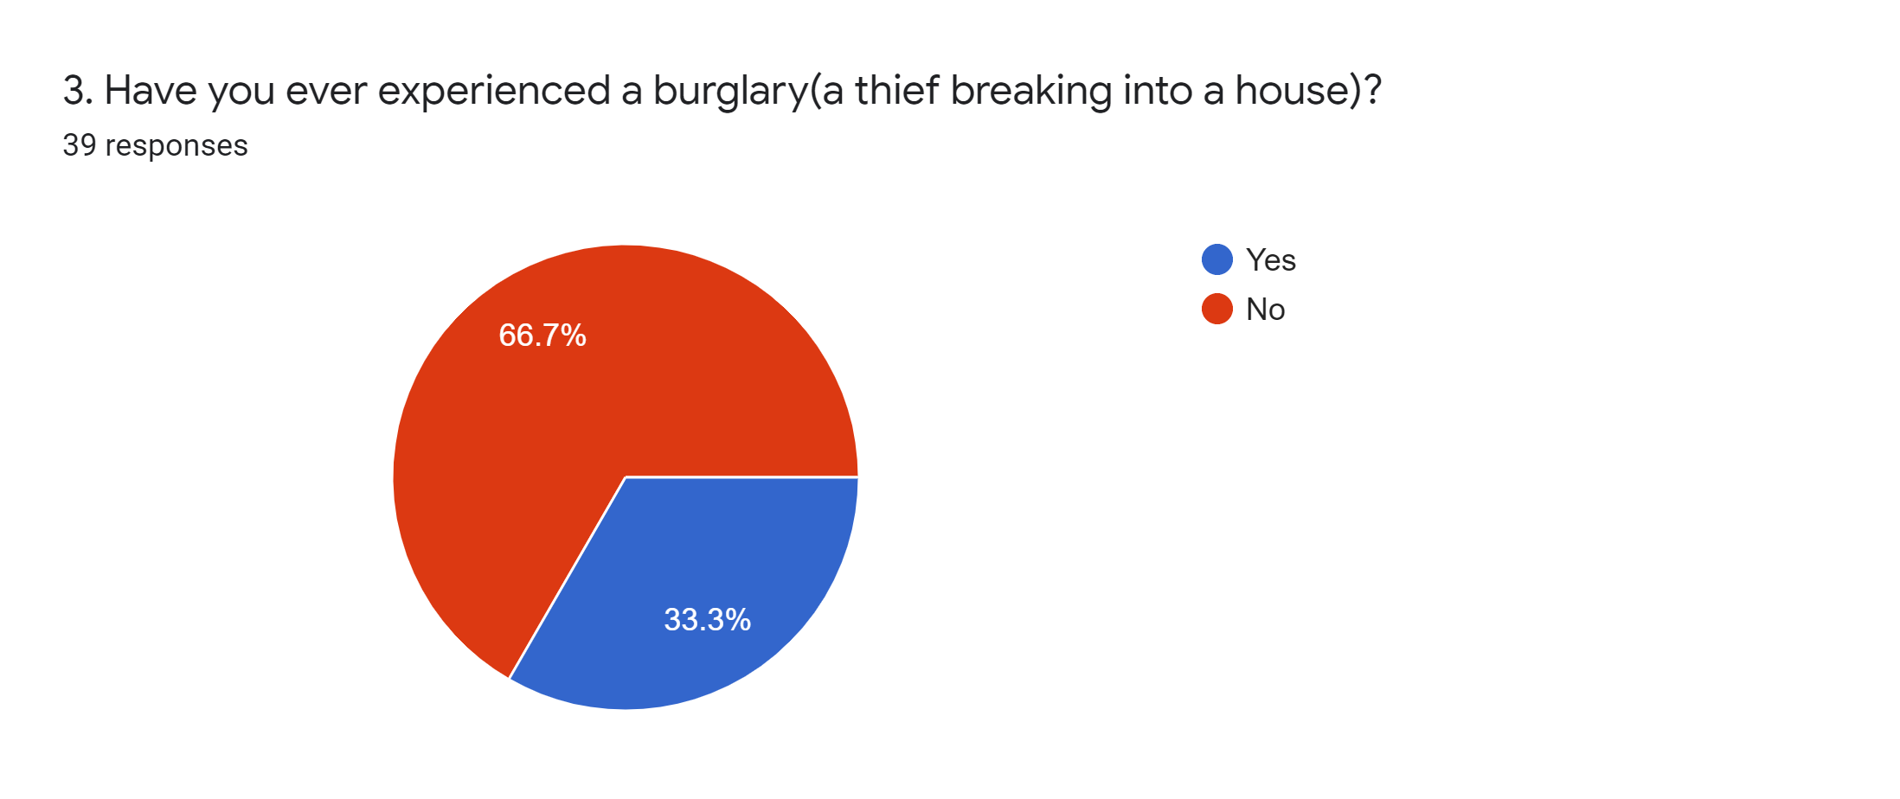
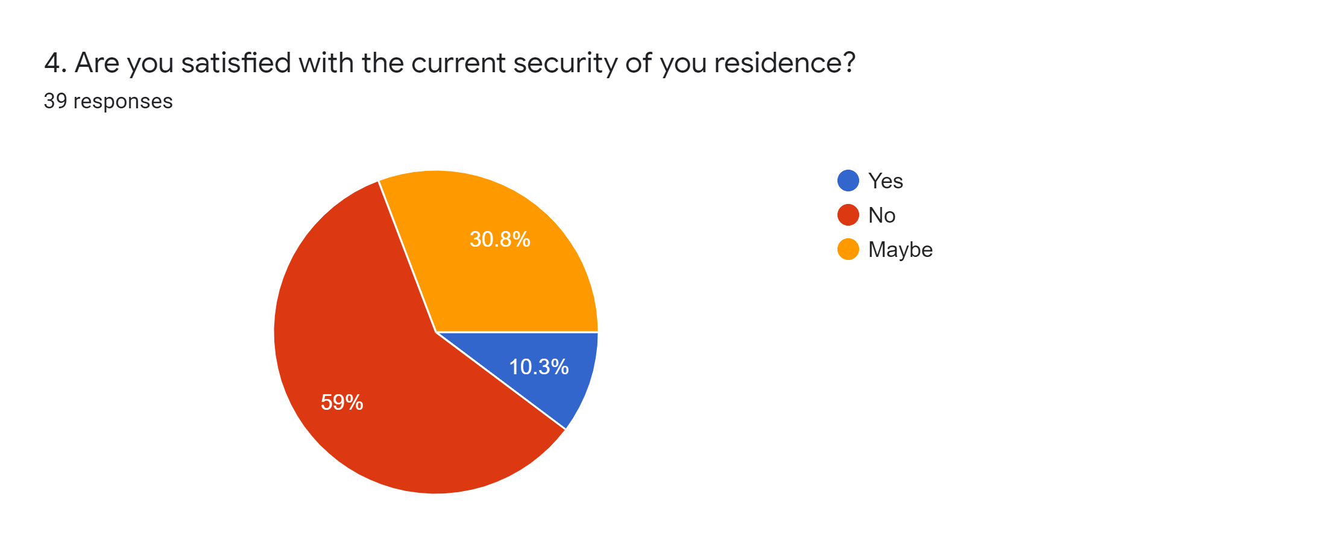
Statistical Analysis for Apartment Security
33.3% of people have experienced a burglary in their houses
59% of people are not satisfied with the security
02

Slide 4
Solution

Slide 5
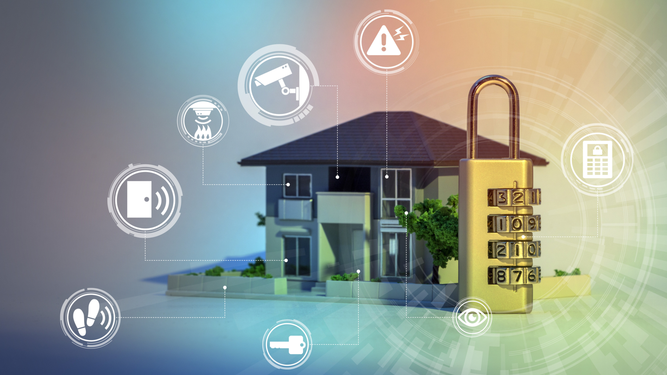
Smart Apartment Security System
Secure entry points and interior spaces
Notifies the owners and security officer
Mobile application is used to be connected with house
The security system will consist of
Sensors ( Door and window sensors, Motion sensor)
Smoke detector
Siren
Smart doorlock
Control unit
Mobile application
03

Slide 6
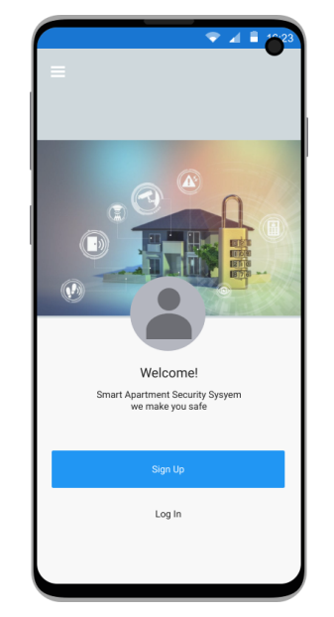
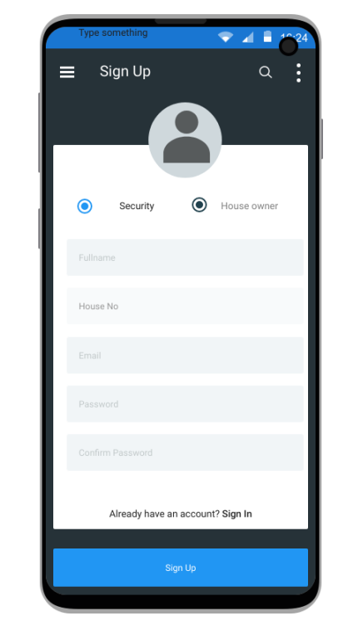
Mobile Application - UI
Common interface for Owner and Security officer for Login & Signup
1.
Login / sign up to application
2.
Sign up to application
04

Slide 7
Mobile Application - UI
Features in Owner’s interface
1.
Selecting Modes
(Home/Away)
2.
Notification log
3.
View status of sensors
4.
Access to Door Lock
5.
Contact Security Officer
6.
Enable/Disable
Alarm
05

Slide 8
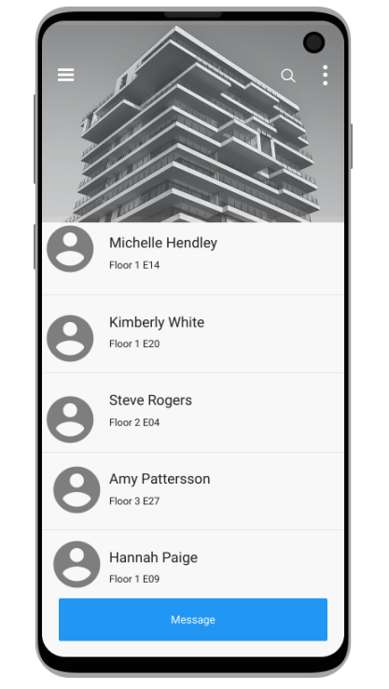
Mobile Application - UI
Features in Security Officer’s interface
1.
Monitor the status of each house
2.
Contact Owners
06

Slide 9
Technical Overview

Slide 10
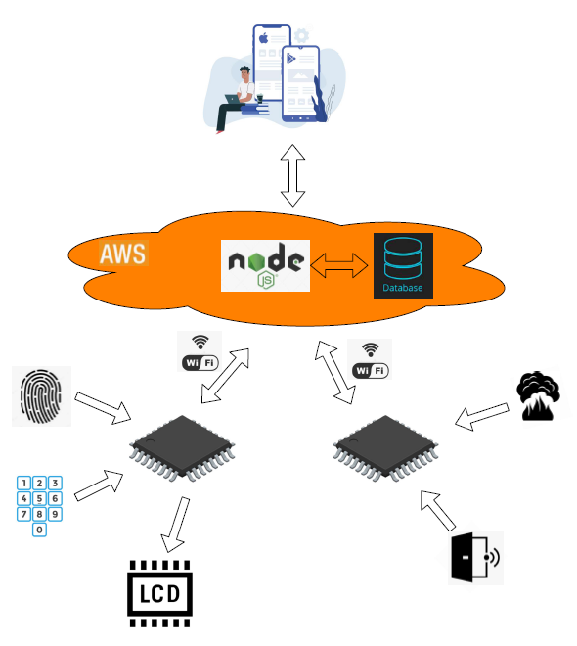
System Overview
07

Slide 11
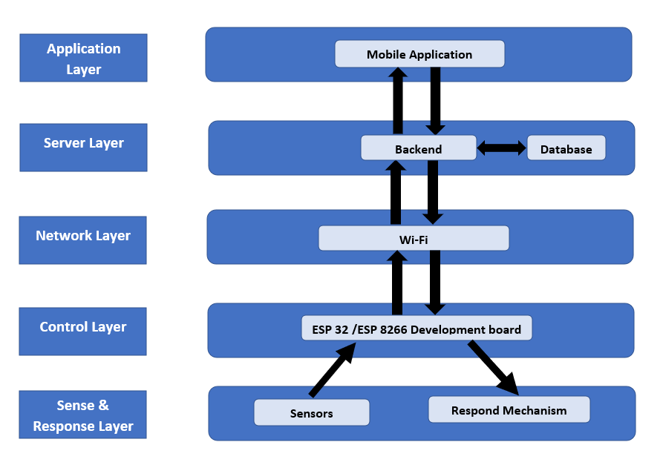
Data and Control Flow
08

Slide 12

Technologies used
Frontend of the mobile application
Flutter
Reduced code development time
Cross platform support
Continuous maintenance
Opensource
09

Slide 13



Technologies used
Backend of the system
MySQL
Ensure ACID Compliance
AWS
As the cloud server
Flexible features
Scalability options
Node JS
Scalability
10

Slide 14
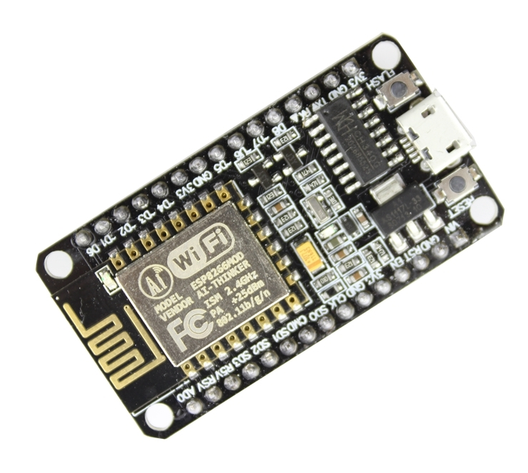
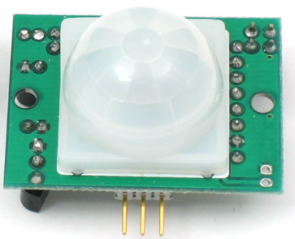
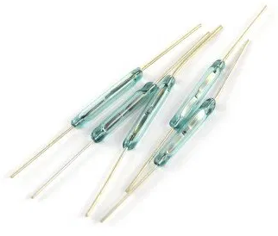
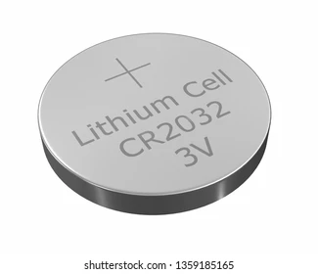
Wireless sensor unit
ESP 01S Wifi Serial Transceiver module
PIR Motion sensor
Reed Switch
(Magnetic field sensor)
Batteries
11

Slide 15
Wireless sensor unit
ESP 01S Wifi Serial Transceiver module
PIR Motion sensor
Reed Switch
(Magnetic field sensor)
Batteries

Slide 16
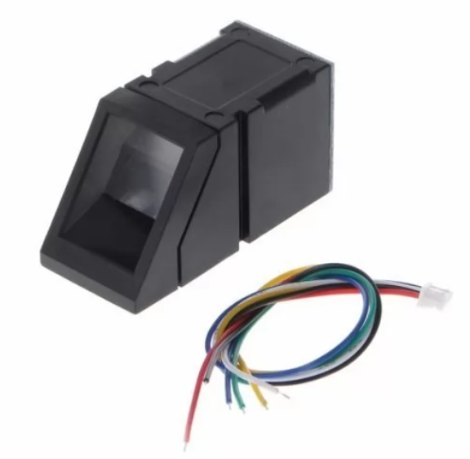
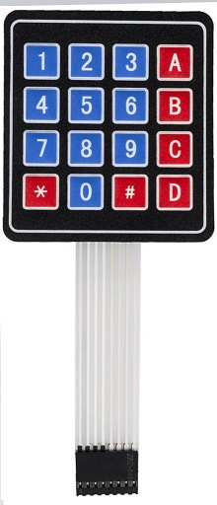
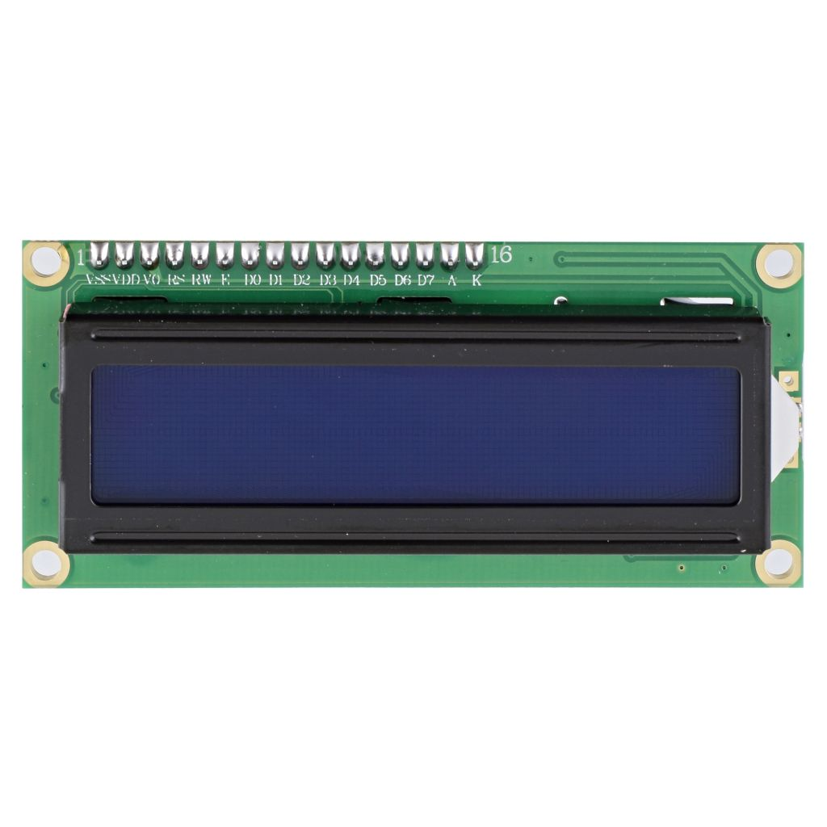
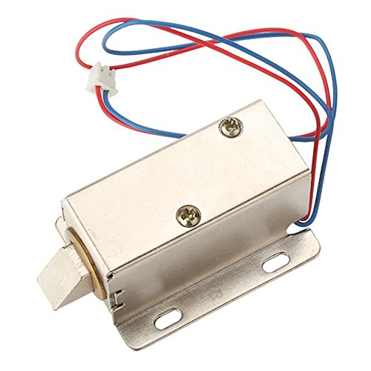
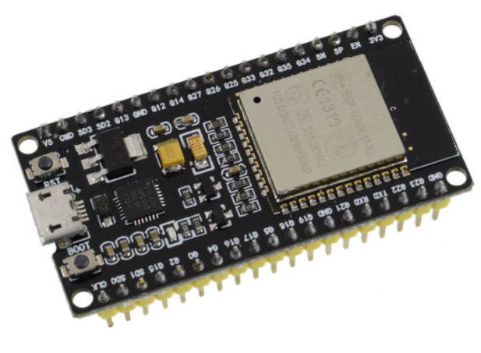
Smart Door Lock
R307 Biometric Fingerprint Reader Sensor
Membrane switch keypad
LCD display
Electro magnetic door lock
ESP 32S development board
12

Slide 17
Smart Door Lock
R307 Biometric Fingerprint Reader Sensor
Membrane switch keypad
LCD display
Electro magnetic door lock
ESP 32S development board

Slide 18
Implications
&
Marketing Plan

Slide 19
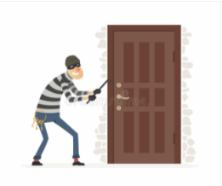


Advantages of Smart Apartment Security System
For Owners
Protection for valuables
Peace of mind
Get Protection while the power failures in house
Reduced home insurance premiums
Being connected with the security officer
13

Slide 20
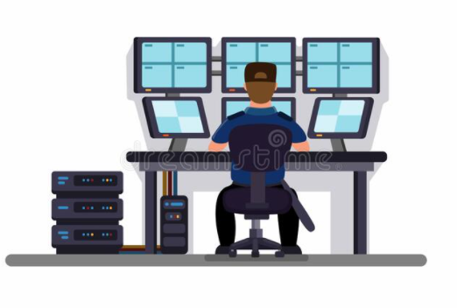
Advantages of Smart Apartment Security System
For Security officer
Easy to monitor all houses
Reducing the workload
For Apartment Construction Company
Increasing the value of the apartment
Less employees needed for security
14

Slide 21

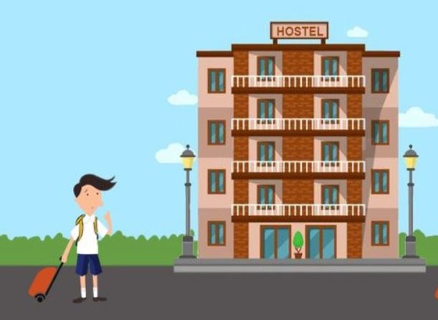
Target Market & Potential Expansions
Target Market
Apartment buildings in urban areas
Potential Expansions
Hotels
Hostels
15

Slide 22
Budget
&
Execution Plan

Slide 23
Budget
Item | Cost per unit (Rs) | No. of units | Cost (Rs)
Fingerprint sensor AS608 | 3000.00 | 1 | 3000.00
LCD display | 320.00 | 1 | 320.00
Membrane Switch keypad | 160.00 | 2 | 320.00
Electric Solenoid Door Lock | 1000.00 | 1 | 1000.00
ESP 32 Development Board | 1500.00 | 1 | 1500.00
PIR Motion sensor module | 220.00 | 1 | 220.00
Magnetic Door Reed Switch with Magnet | 135.00 | 2 | 270.00
ESP8266 ESP-12 D1 Mini WFi Development board | 750.00 | 2 | 1500.00
12V 2A SMPS Power Adapter | 500.00 | 1 | 500.00
Li-ion 18650 Rechargeable battery | 350.00 | 3 | 1050.00
Battery Holder | 80.00 | 2 | 160.00
Flame sensor module | 120.00 | 1 | 120.00
Buzzer | 35.00 | 2 | 70.00
Other | 1500.00 |  | 1500.00
Total | 11530.00
16

Slide 24
Project Timeline
Week 1
Week 2
Week 3
Week 4
Week 5
Week 6
Week 7
Week 8
Week 9
Week 10
Week 11
Week 12
Week 13
Week 14
Week 15
Front End
Back End
Control unit design
Security System
Testing
Phase 1
Front End
Phase 2
Back End
Phase 3
Control Unit
Phase 4
Security system
Phase 5
System testing
Creating the front-end using Flutter
Creating the back-end using Node.js and MySQL
Design the control unit with ESP development board
Hardware implementation
Thoroughly test the system

Slide 25
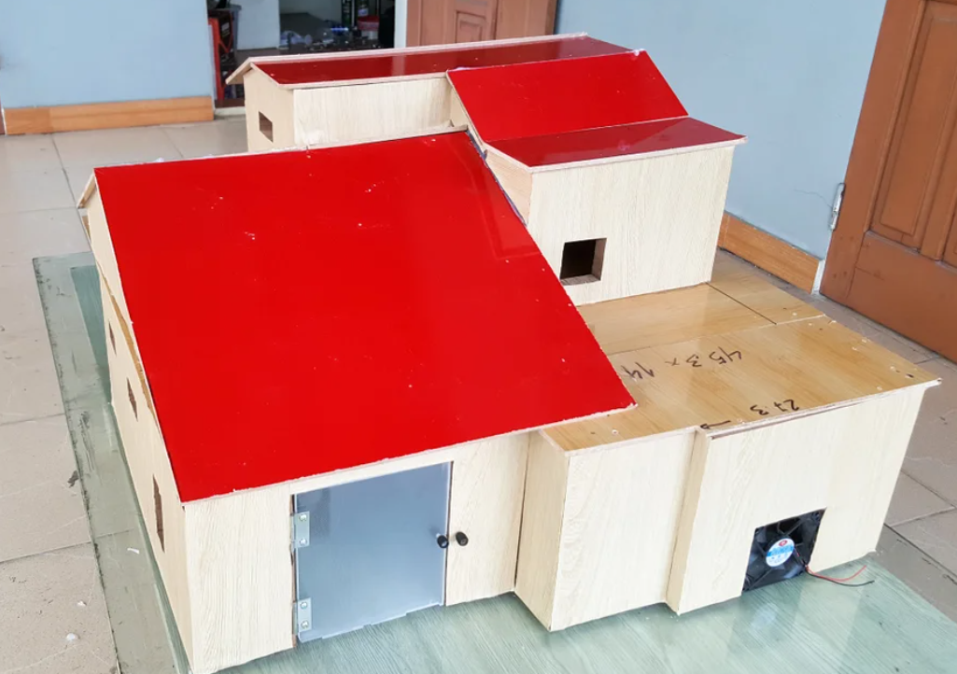
Demonstration plan
Model house (One block of house in the apartment)
Screen Recording of Mobile App
18

Slide 26
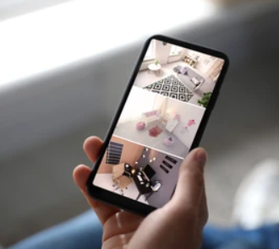
Future Developments
Adding cameras to the system - user can get a live view of house whenever needed.
Power optimization
19

Slide 27
Thank You !

Slide 28
Q & A

Slide 29

Power Supply
Door/Window sensor
Fingerprint module
ESP32
ESP8266
Flame sensor
Keypad
PIR motion sensor
LCD display
Buzzer
AWS server
Backend
Database
Mobile Application
Web Application

